Slide 1


CogSketch
You Try It
CPTTE 2016
Ken Forbus, Maria Chang, Madeline Usher
Northwestern University

Slide 2
Overview
Doing a worksheet
  Drawing and labeling glyphs
Making a worksheet
  Tackling a common misconception
What we’re not showing today
  Using arrows (relation glyphs) to express relationships
  Using annotations to provide additional information, like lengths and mass
  These are described in the on-line tutorials and the manual

Slide 3
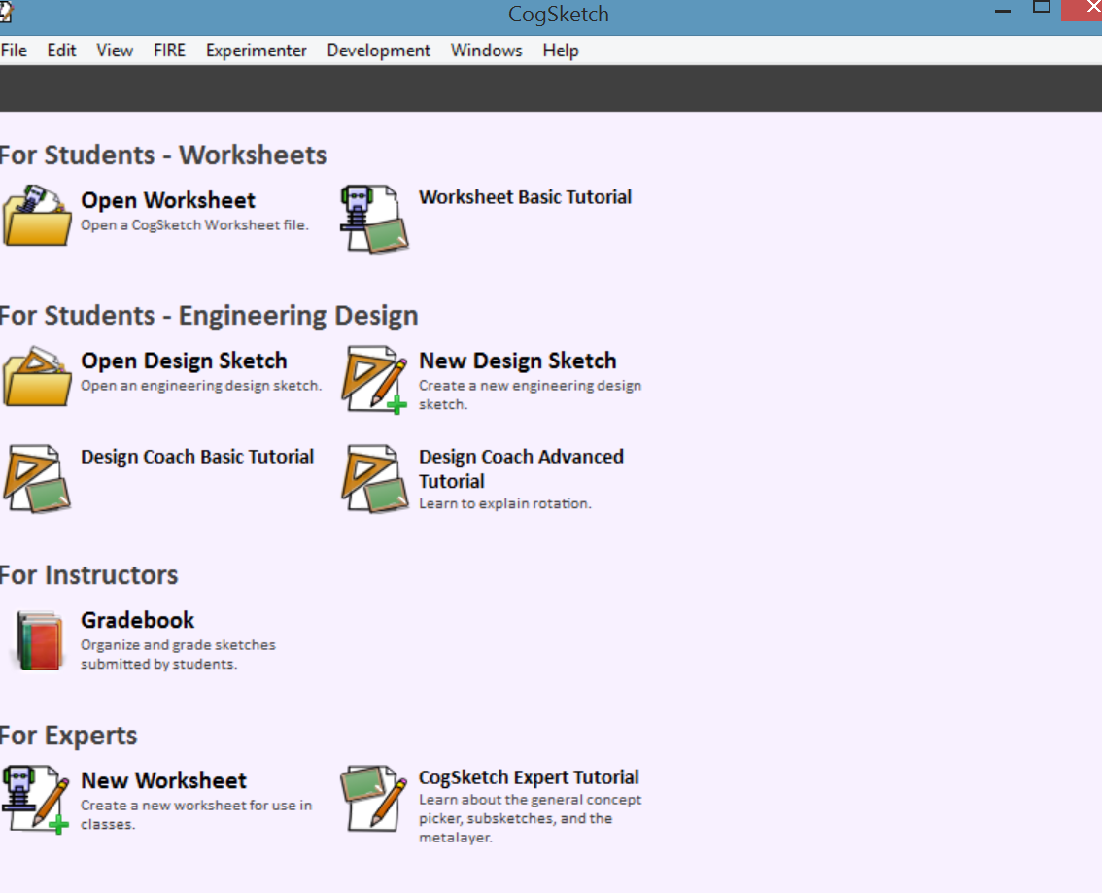
What You See When Starting CogSketch
Choose Open Worksheet, select Cell worksheet

Slide 4
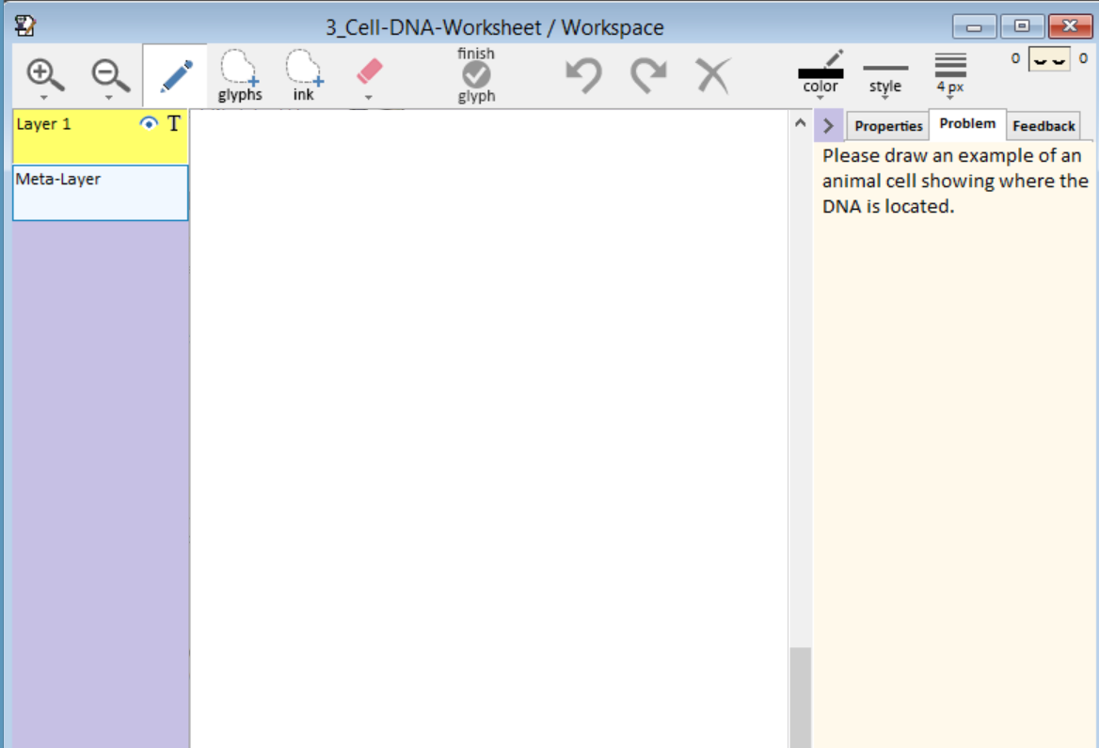
Cell/DNA worksheet
Problem Statement = What you need to do
Each element of the sketch is a glyph. Each needs to be drawn separately, or split later

Slide 5
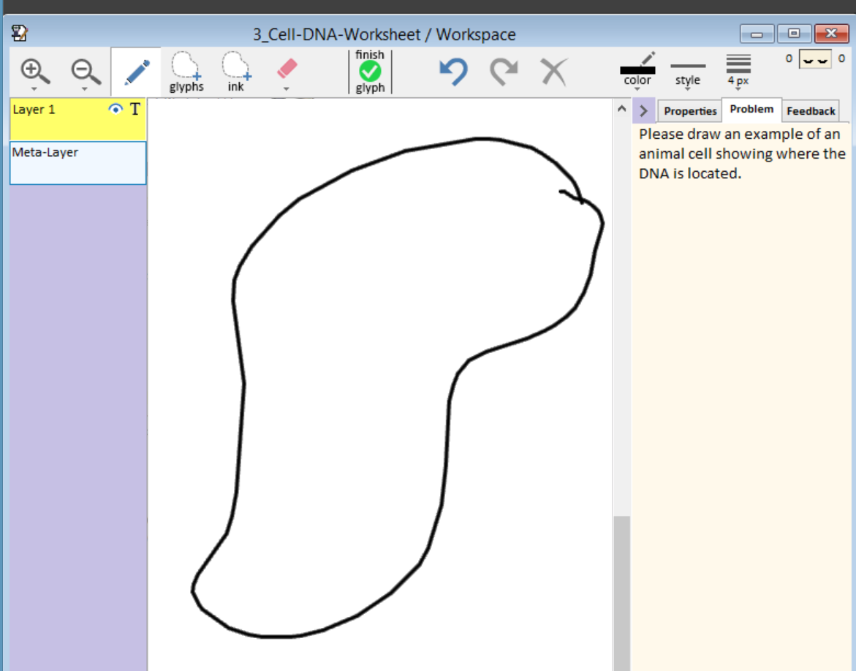
Hit Finish Glyph when you’re done drawing the cell membrane

Slide 6
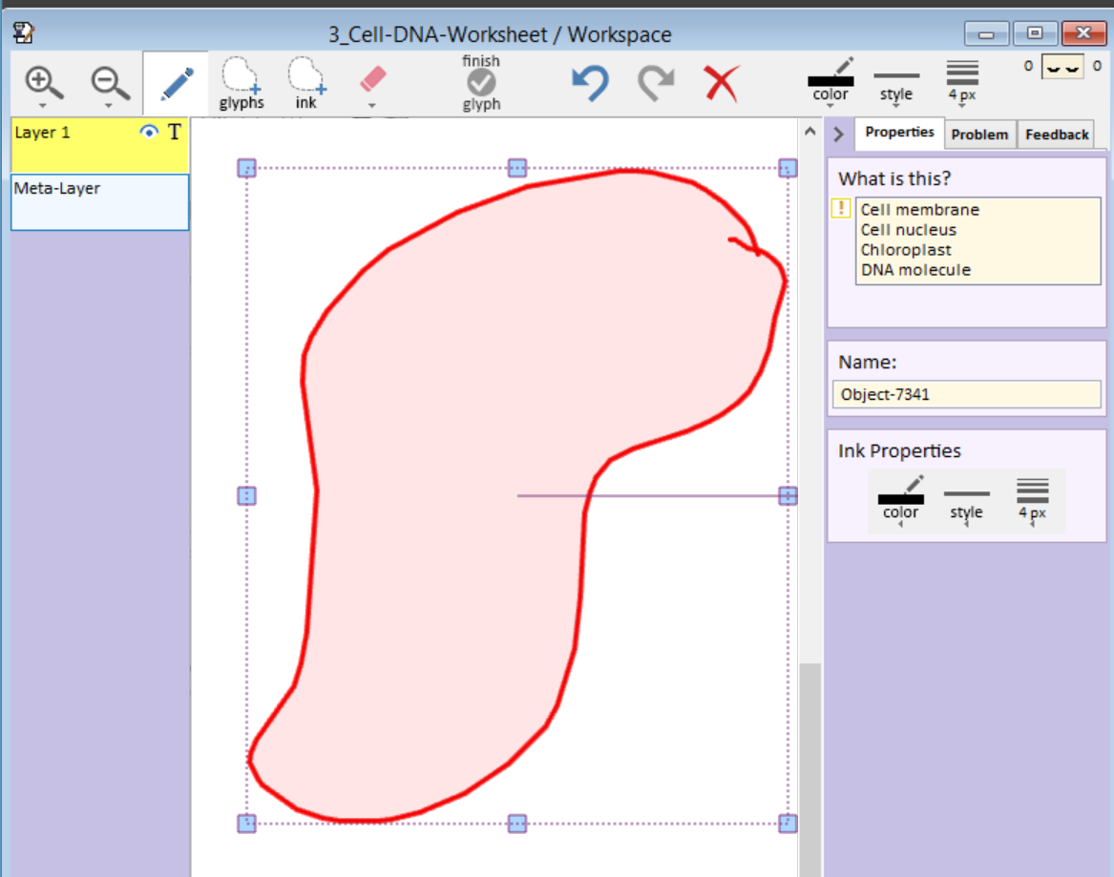
Conceptually Label What you Just Drew

Slide 7
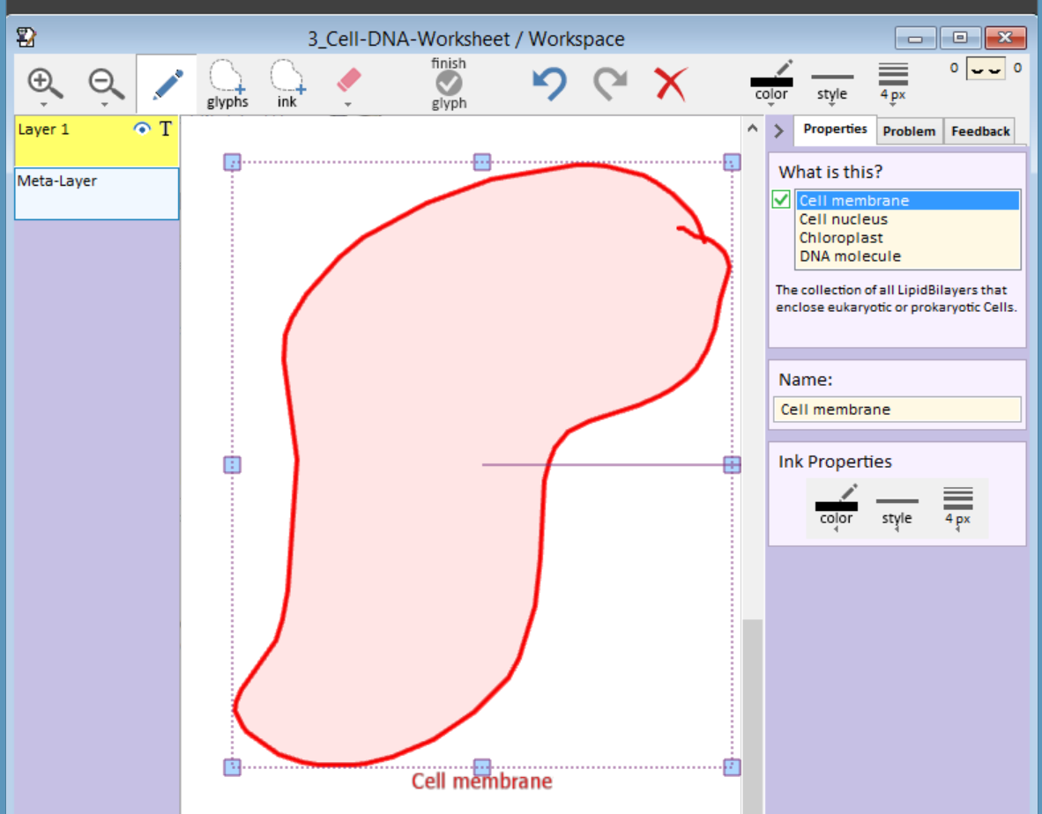
CogSketch now knows what you mean

Slide 8
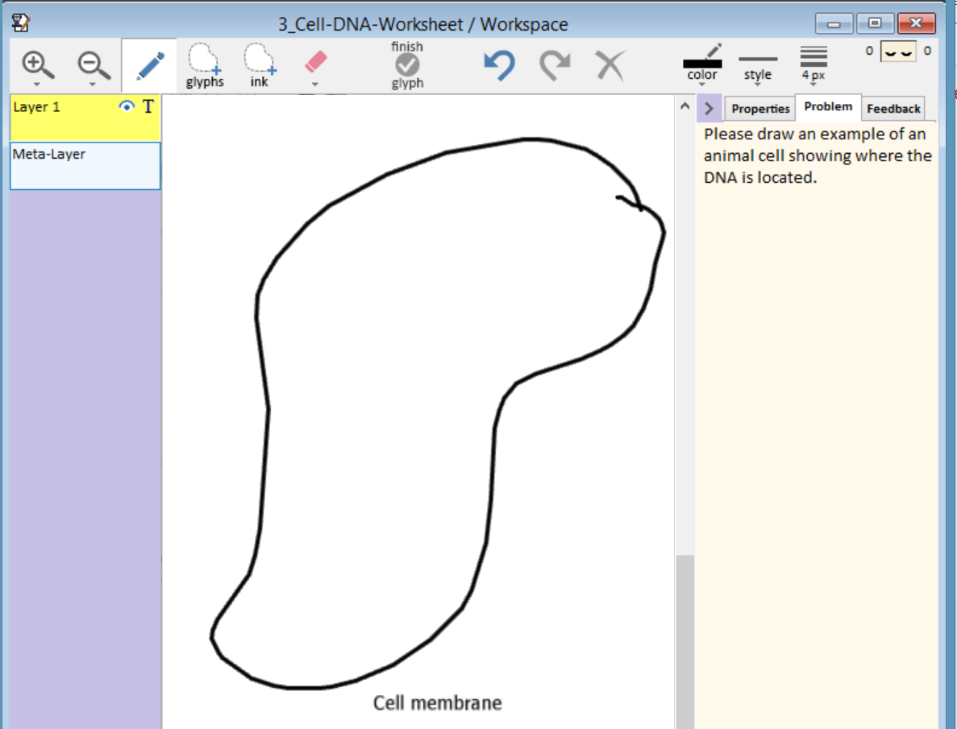
Still Need to draw the Nucleus and DNA

Slide 9
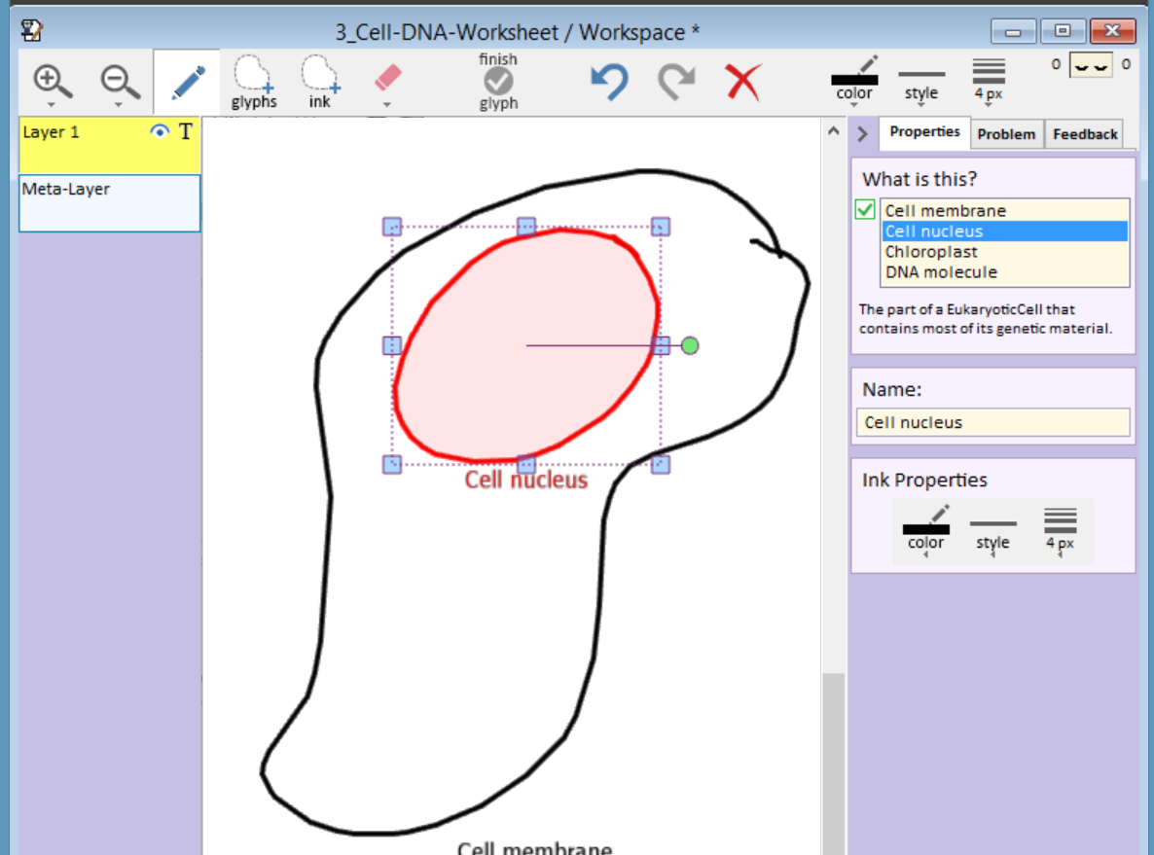
One Version of the Nucleus
CogSketch perceives certain visual relationships, such as one glyph being inside another

Slide 10
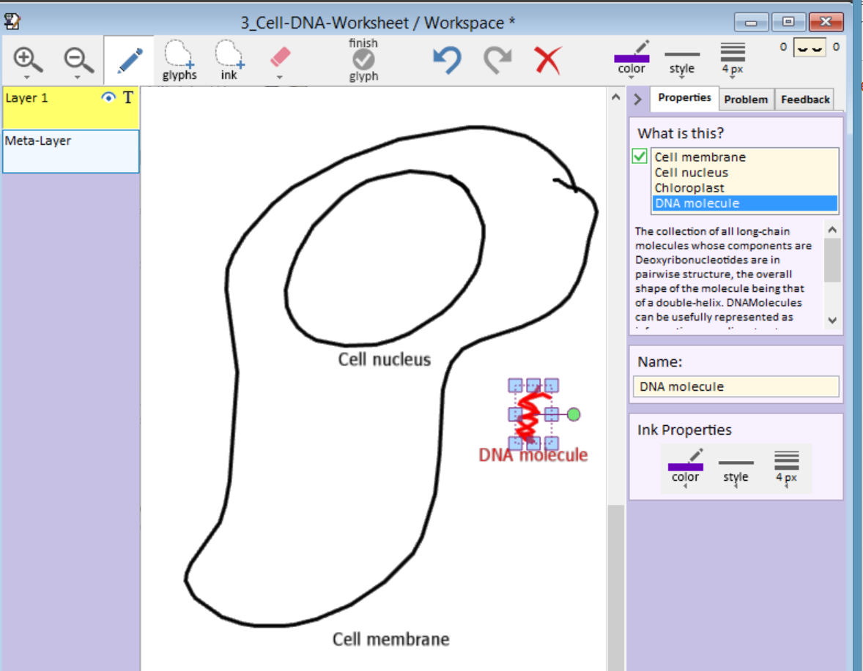
Let’s be confused about the DNA

Slide 11
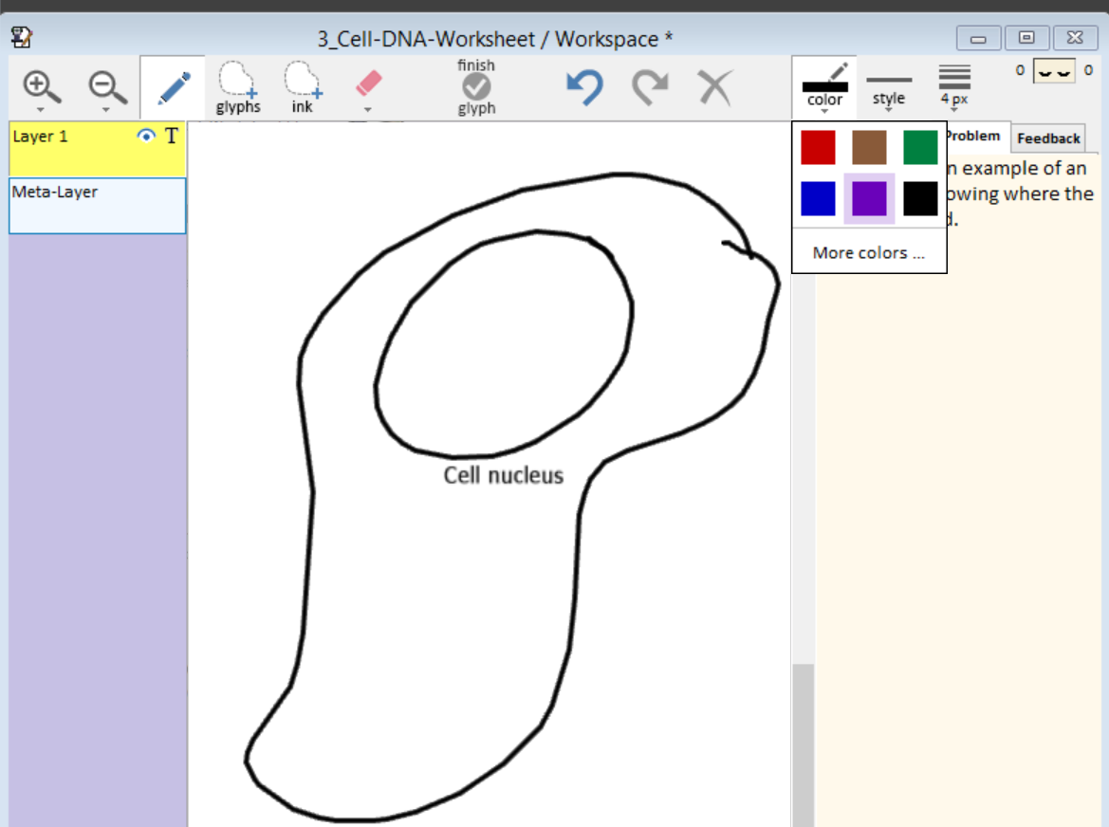
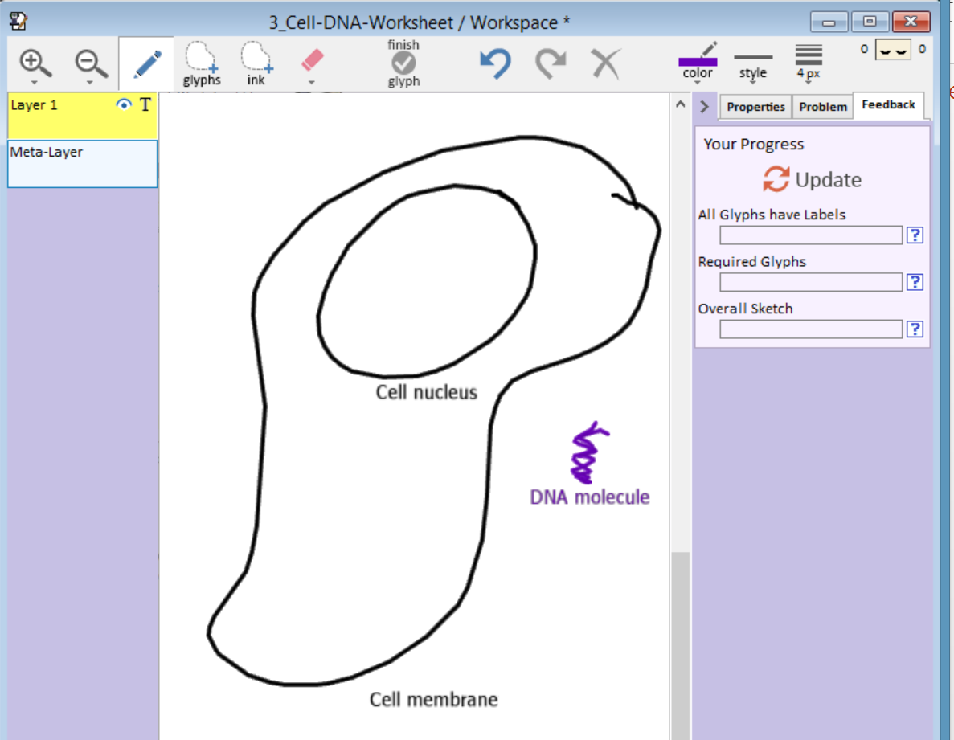
Choose the Feedback Tab

Slide 12
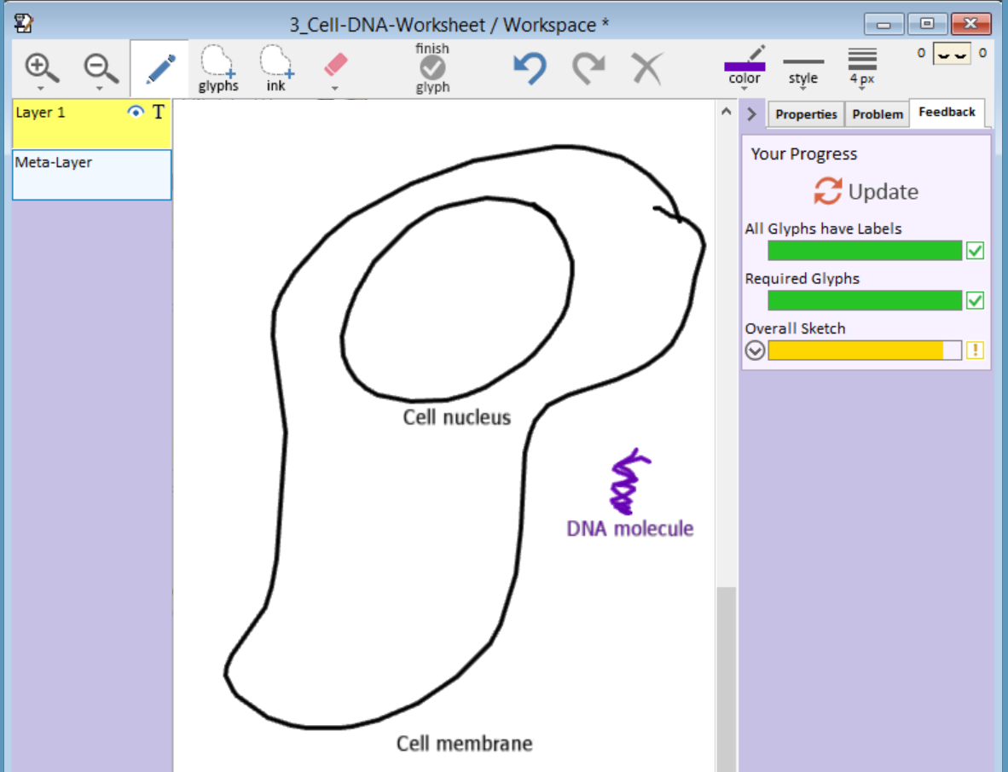
Click on Update to get advice

Slide 13
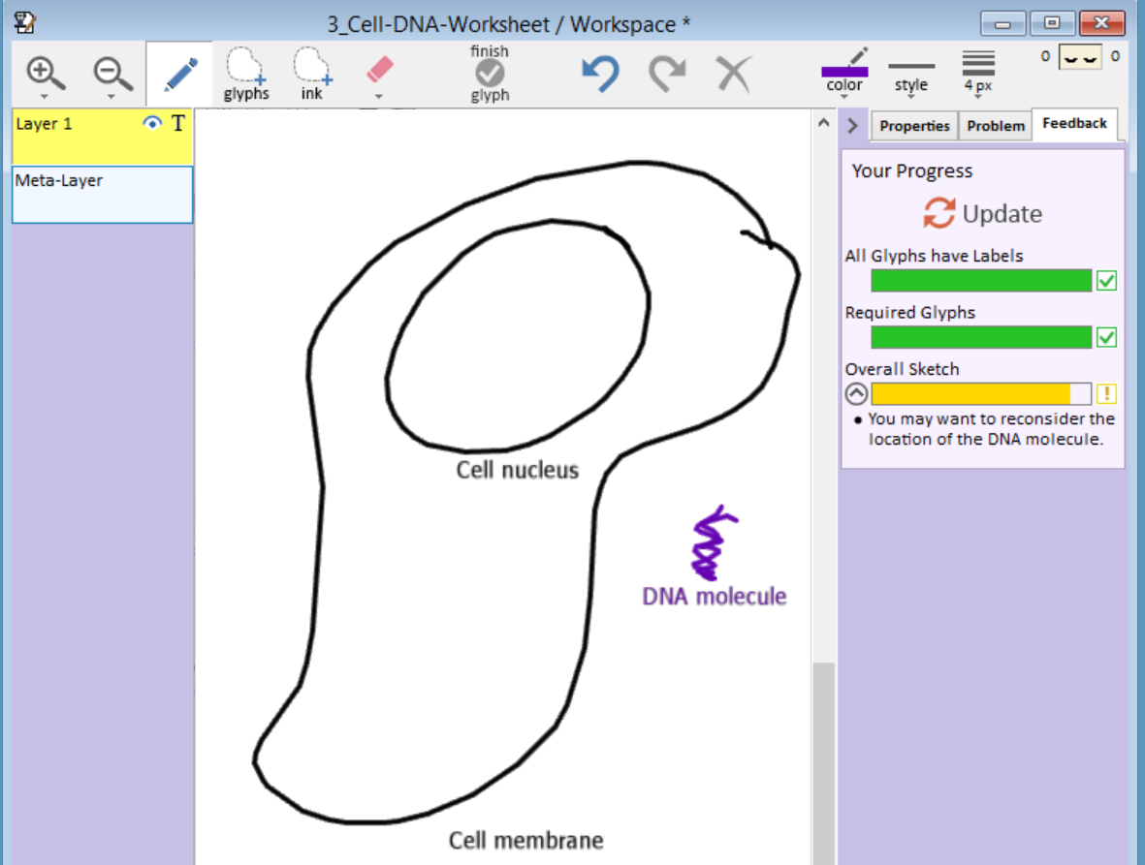
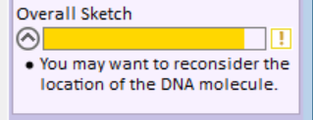

Slide 14
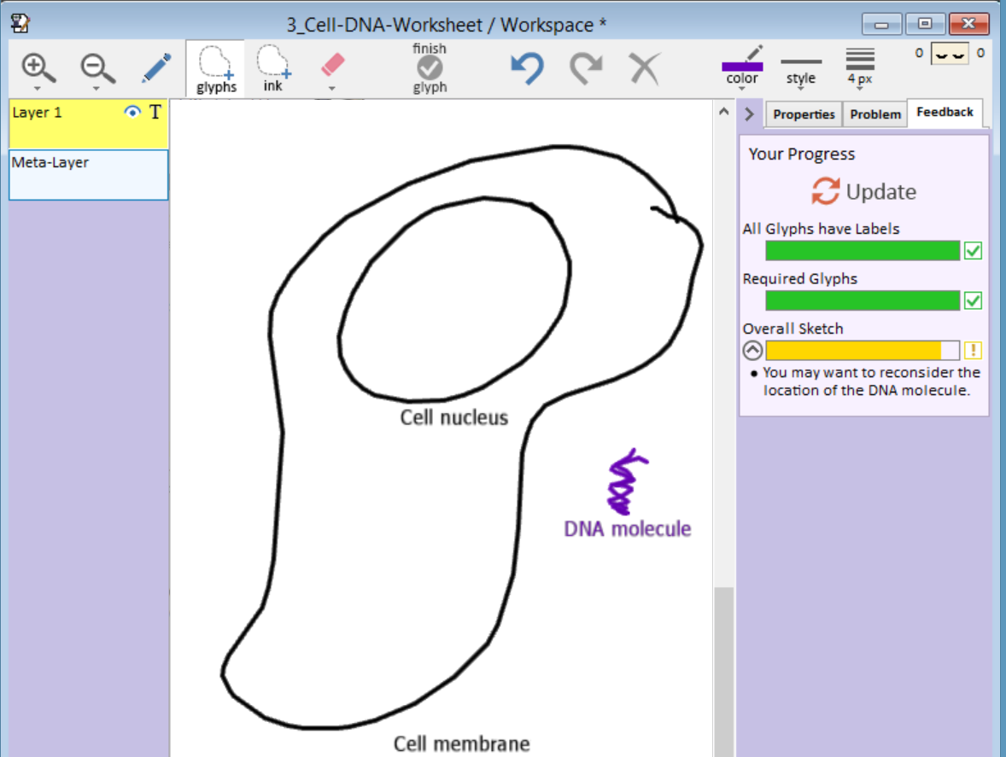
Select the Glyph Lasso, to move the DNA

Slide 15
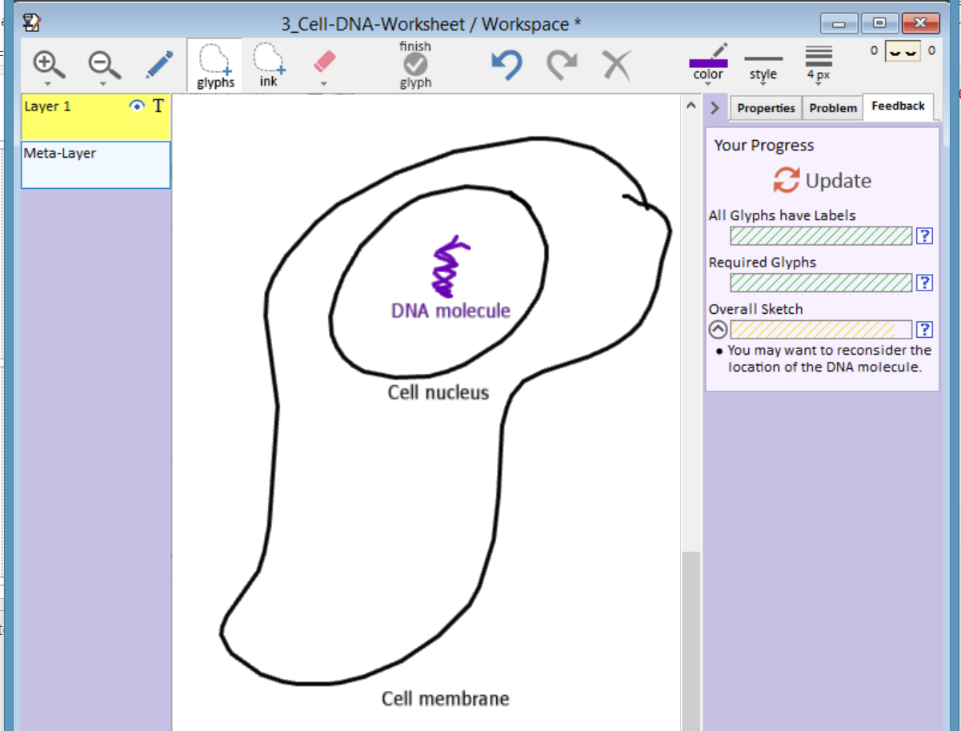
Repositioned DNA – Note advice now out of date, so hashed out

Slide 16
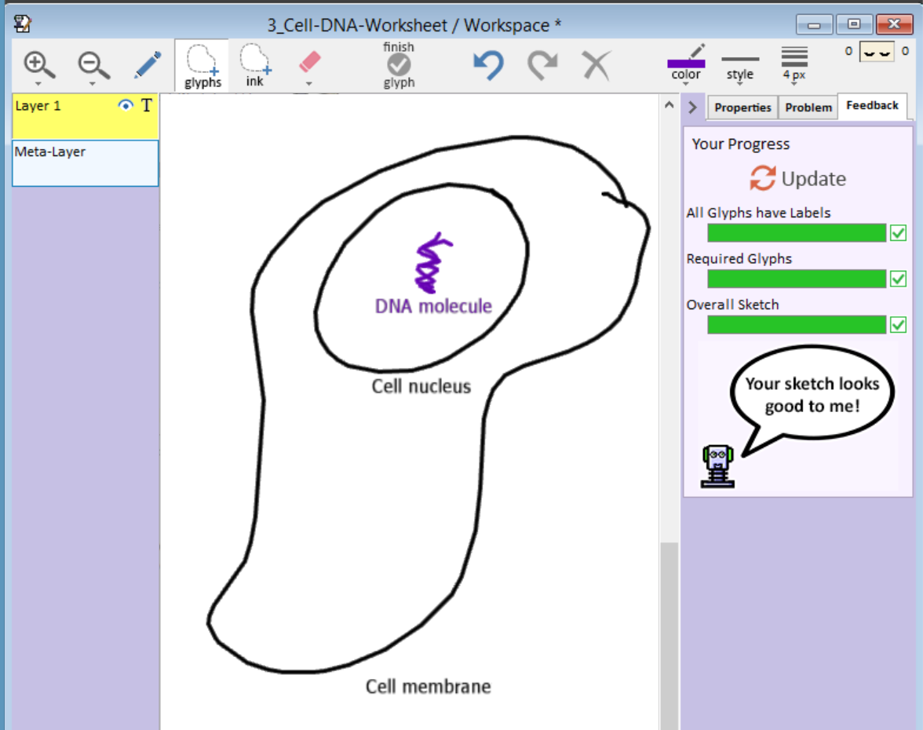
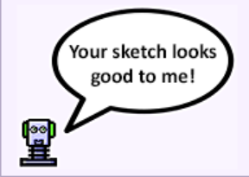

Slide 17
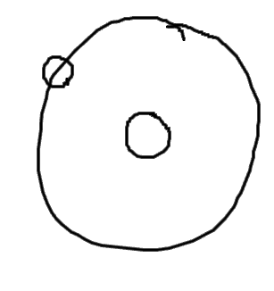
Creating a Sketch Worksheet
Does the Earth go around the Sun, or does the Sun go around the Earth?
Sun
NSF, Science & Engineering Indicators 2014
Earth
Response of 26%
of Americans
Notes:
Spatialized visual symbols need to be treated differently in sketch understanding software. The conventional approach is to do recognition, but that doesn’t work for many stem domains. For example, what does this diagram on the right illustrate? Is it a hydrogen atom? In this case, it’s part of our solar system, an answer to this question, does the Earth go around the Sun or does the Sun go around the Earth? If you want to know that someone has the right answer, you have to ask them what they mean by each of these components: 26% of Americans would label it this way, alas. Our approach to sketch understanding provides simple ways to tell the software what you mean.

Slide 18
Cooking Show Model
We have started such a worksheet
We’ll walk through how it was made
You will finish it

Slide 19
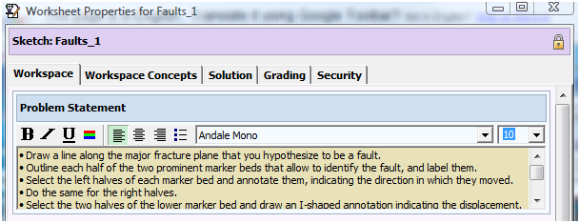
Sketch Worksheet Authoring
Create problem statement
Select subset of concepts student will see
Draw solution sketch
  CogSketch automatically generates facts
Add coaching advice for important facts
Add grading rubrics

Slide 20
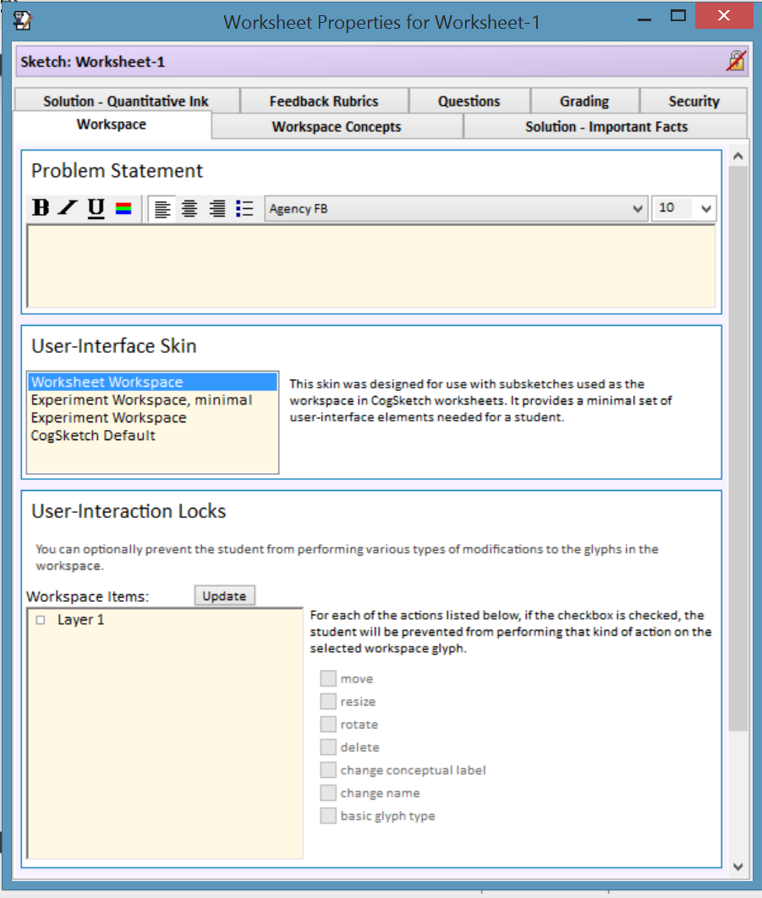
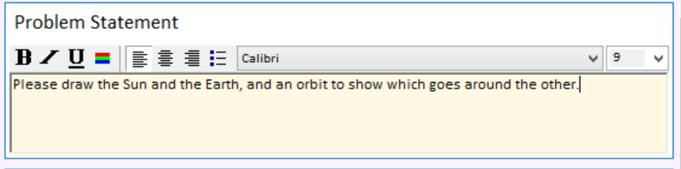
File, then New Worksheet
Type in your Problem Statement

Slide 21
Sketch Worksheet Authoring
Create problem statement
Select subset of concepts student will see
Draw solution sketch
  CogSketch automatically generates facts
Add coaching advice for important facts
Add grading rubrics

Slide 22
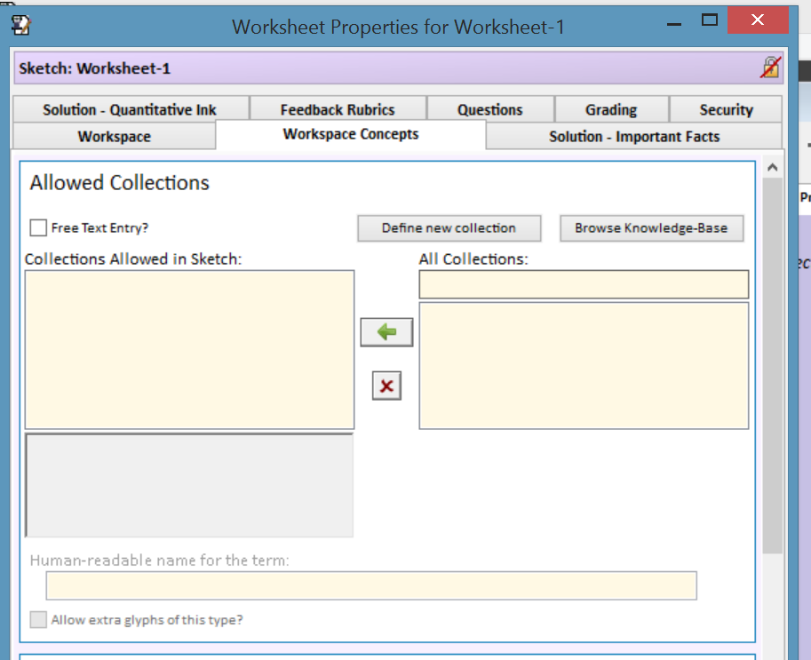
Select Workspace Concepts tab
Collection = Concept. Think of them like sets

Slide 23
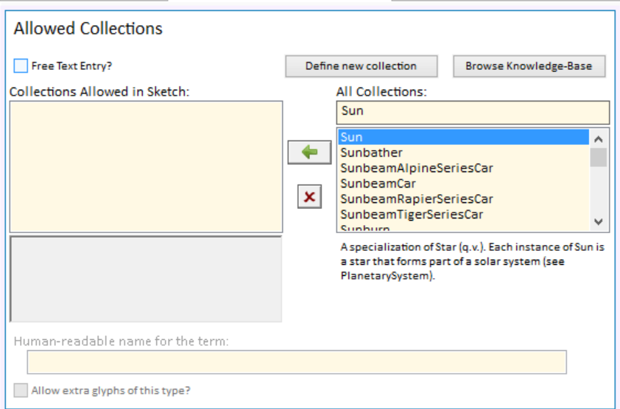
Start Typing a Concept Name
Finding the right concept can be tricky. But mostly CogSketch doesn’t care, which simplifies things.
You are browsing through the OpenCyc ontology, with 58,000 concepts.

Slide 24
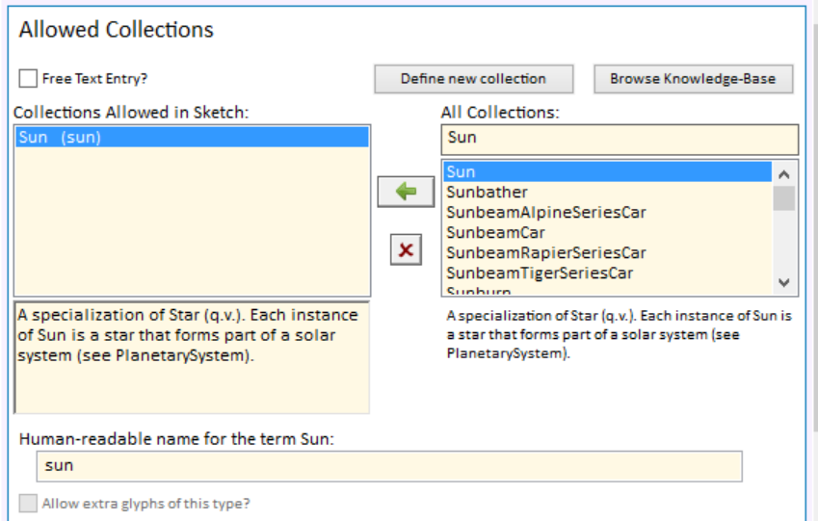
Click Arrow to Include in Sketch

Slide 25
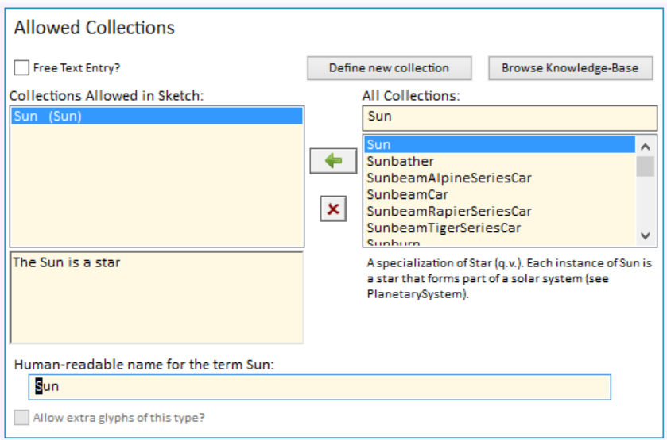
You can change the comments and name
Can choose age-appropriate wording, or non-English language. CogSketch doesn’t care.

Slide 26
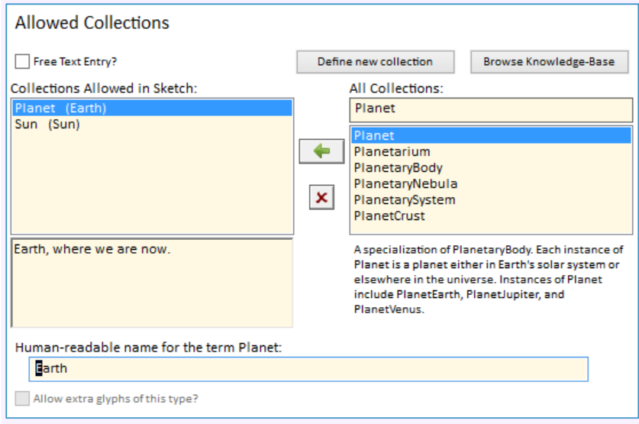
Picking Concepts, not Individuals

Slide 27
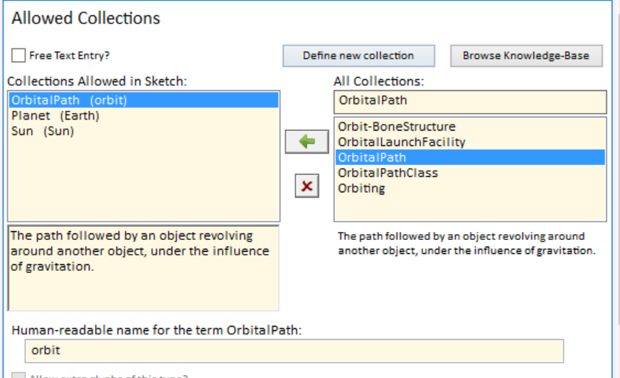
Adding the Orbit

Slide 28
Sketch Worksheet Authoring
Create problem statement
Select subset of concepts student will see
Draw solution sketch
  CogSketch automatically generates facts
Add coaching advice for important facts
Add grading rubrics

Slide 29
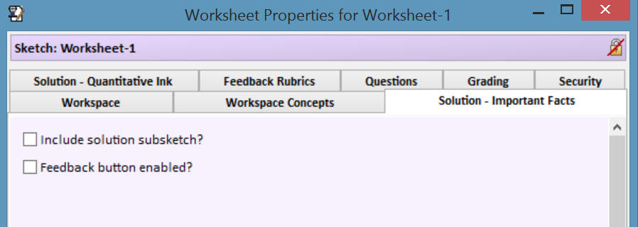
Choose the Solution – Important Facts tab
Select both of these

Slide 30
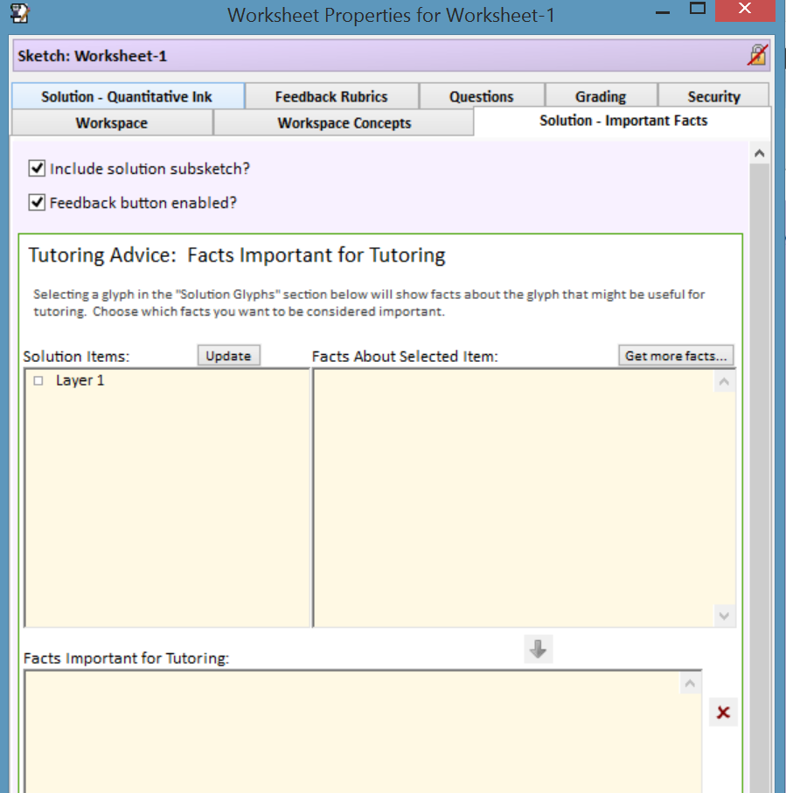
After Selecting Them

Slide 31
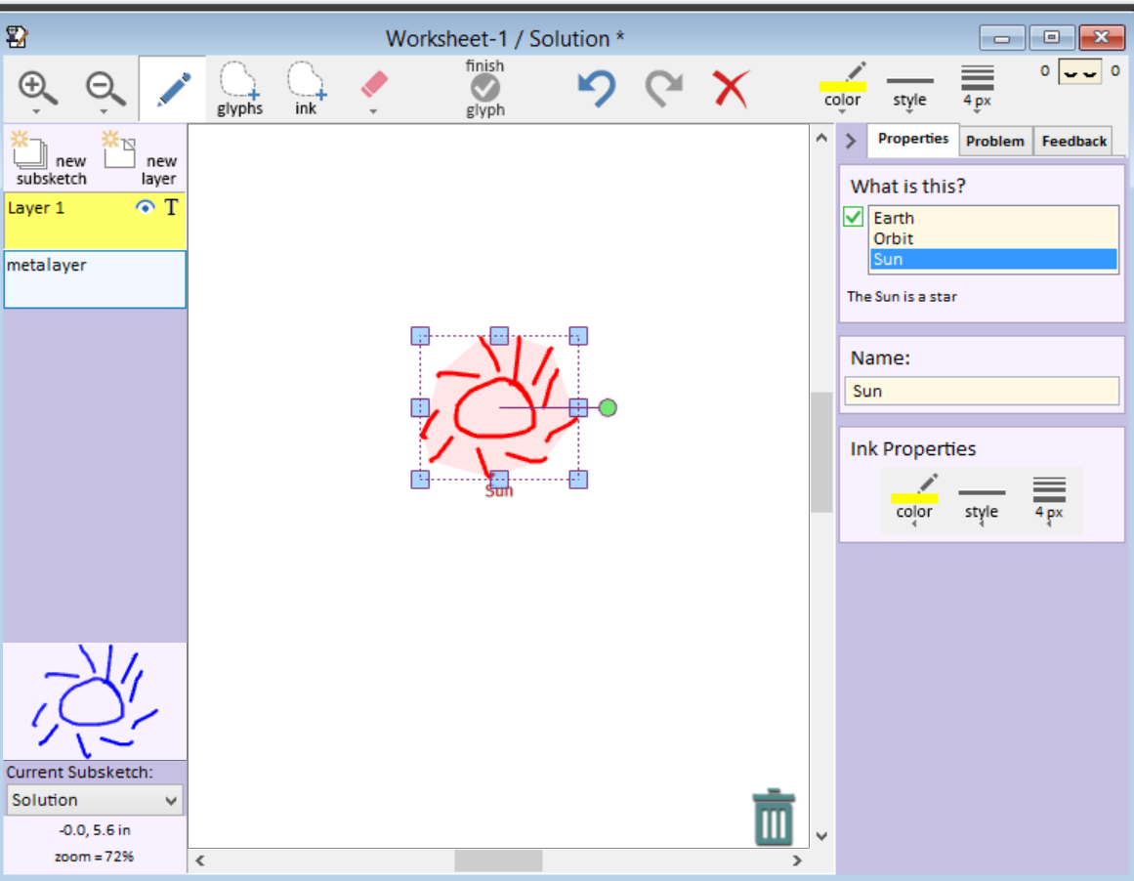
Draw Your Solution
Make sure you’re in the Solution subsketch

Slide 32
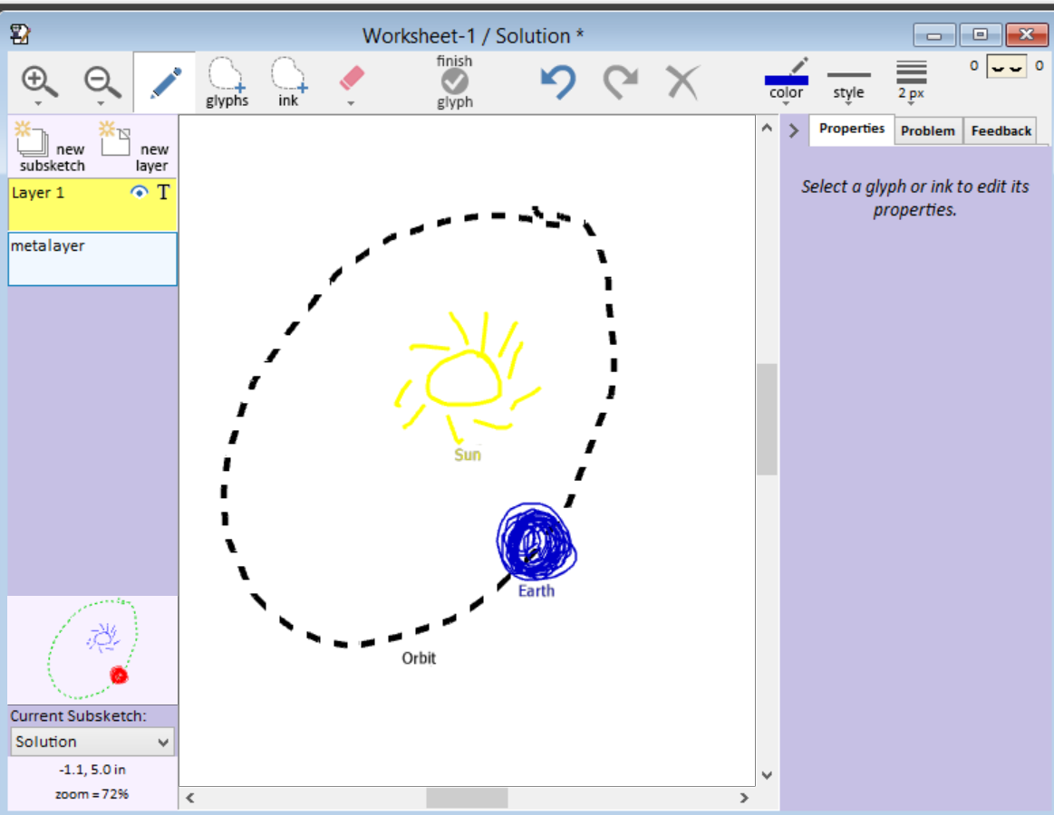
A not-unreasonable solution sketch

Slide 33
Sketch Worksheet Authoring
Create problem statement
Select subset of concepts student will see
Draw solution sketch
  CogSketch automatically generates facts
Add coaching advice for important facts
Add grading rubrics

Slide 34
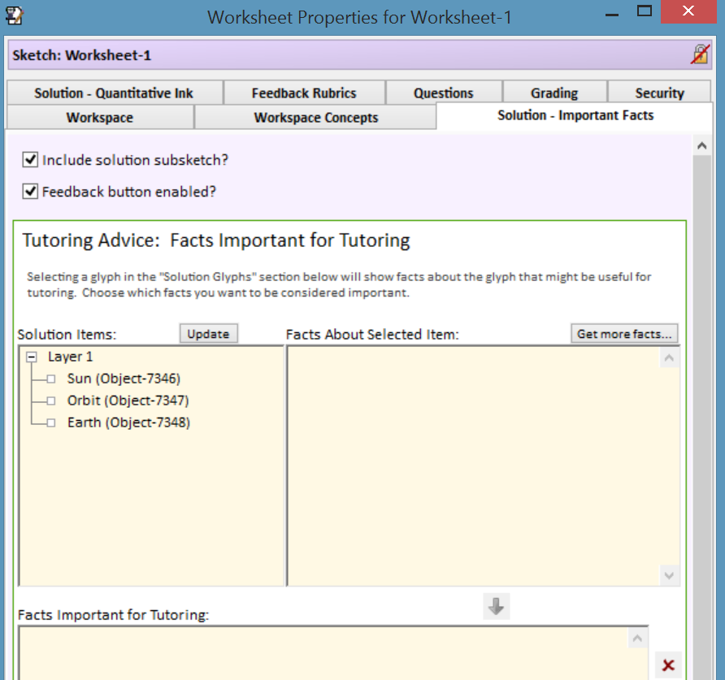
Go back to Worksheet Properties Editor

Slide 35
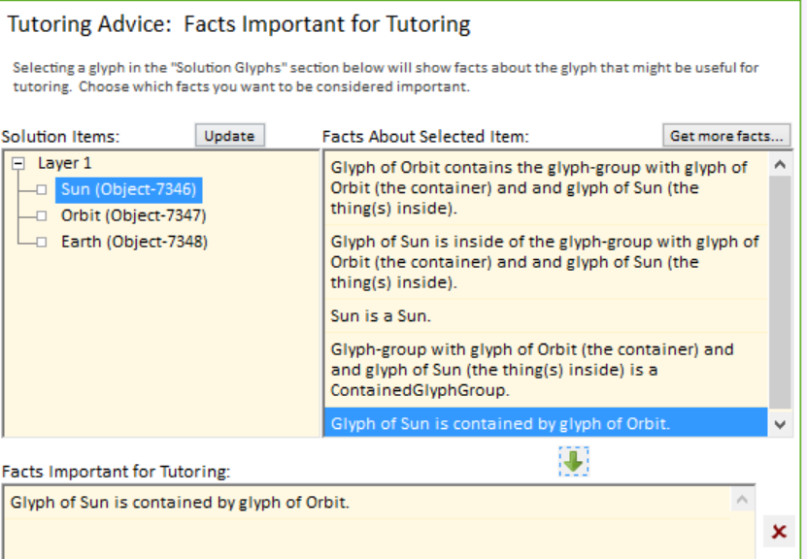
Select Facts that must Hold in Student’s Sketch

Slide 36
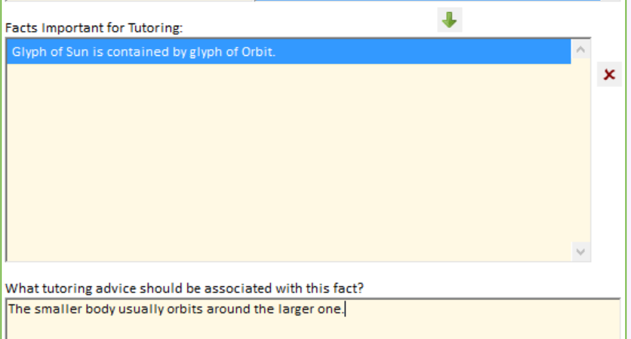
Add Advice to Give if not True

Slide 37
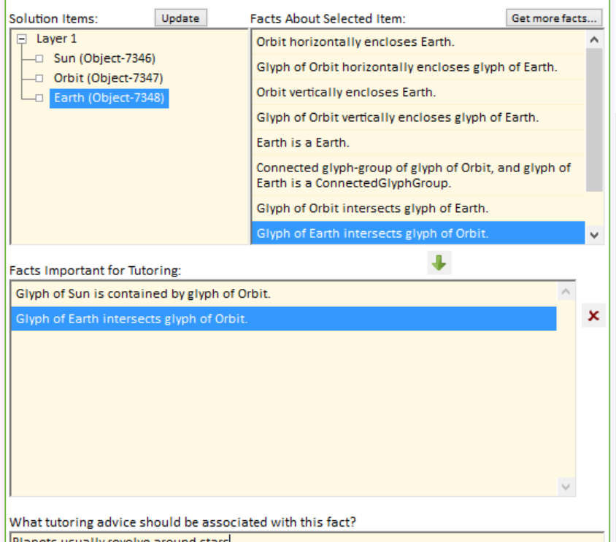
Do this for all Important Facts

Slide 38
Sketch Worksheet Authoring
Create problem statement
Select subset of concepts student will see
Draw solution sketch
  CogSketch automatically generates facts
Add coaching advice for important facts
Add grading rubrics

Slide 39
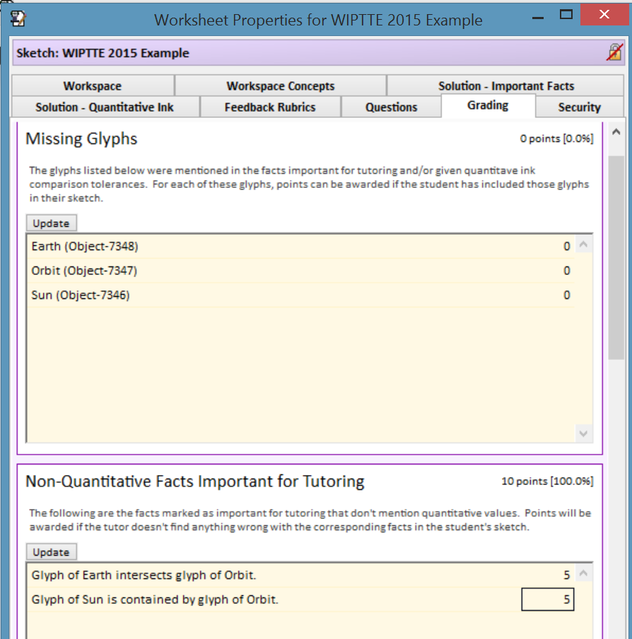
Points tied to Important Facts

Slide 40
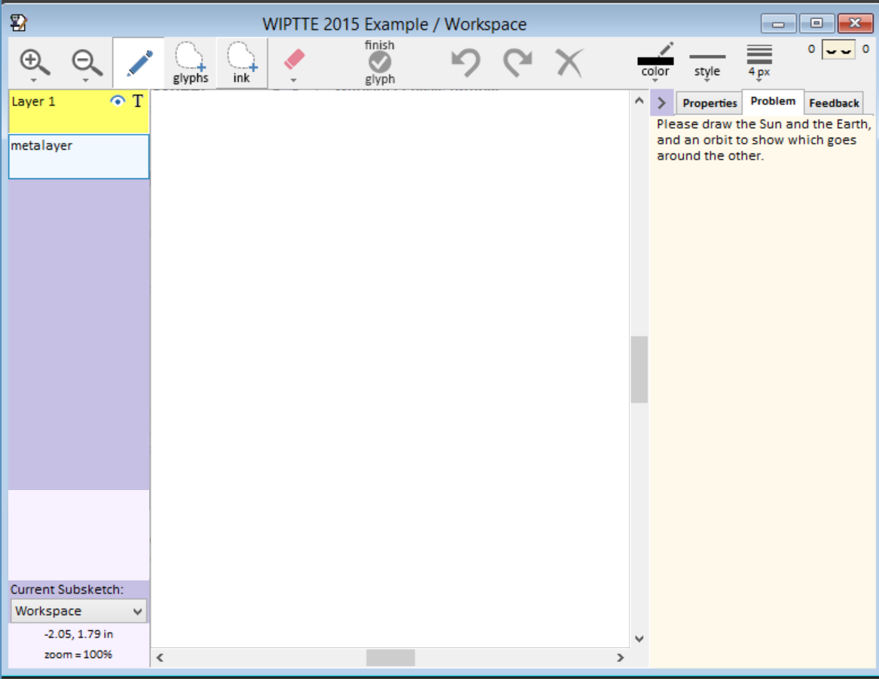
Test by drawing solutions in the Workspace
Should say Workspace

Slide 41
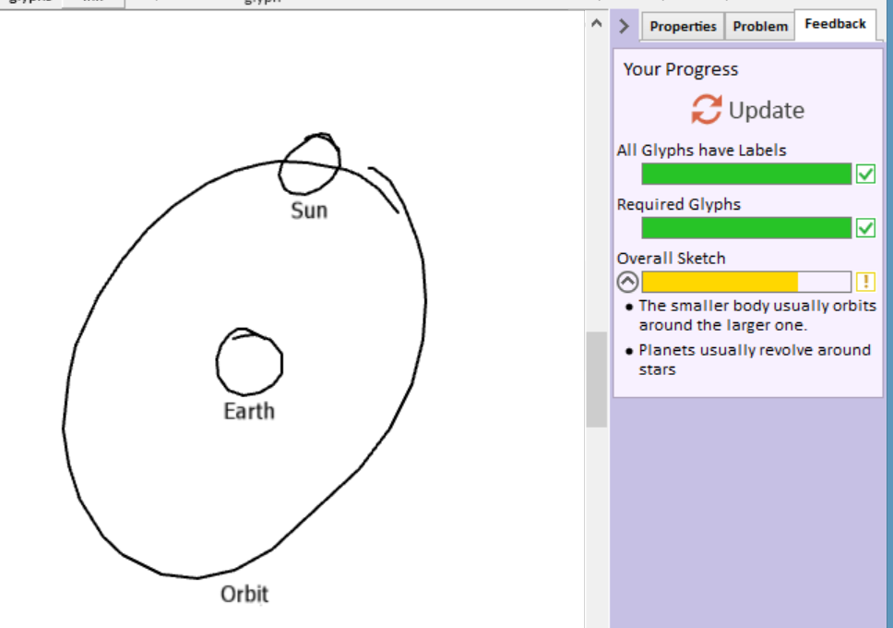
An Incorrect Solution

Slide 42
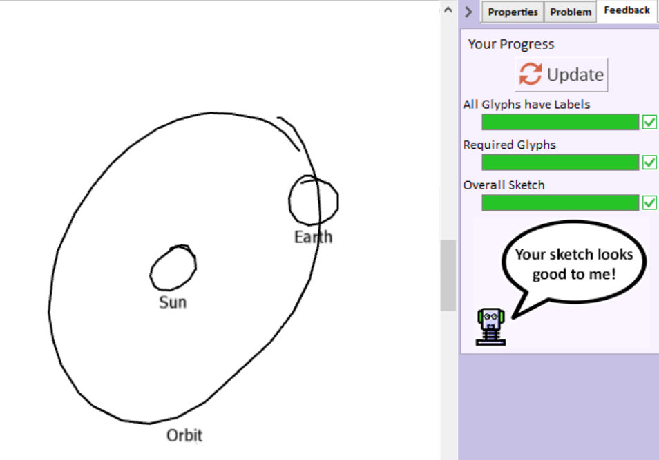
Make Sure they can Succeed

Slide 43
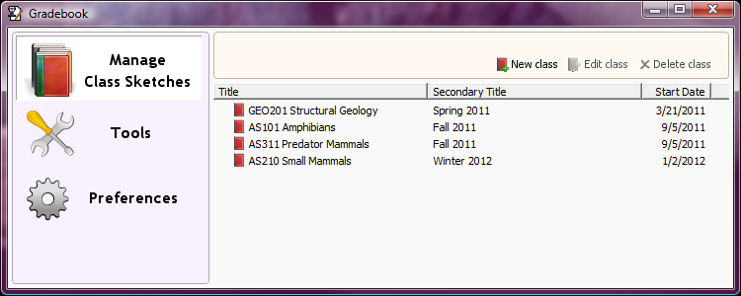
CogSketch Gradebook
A tool for organizing and grading sketches submitted by students.
The gradebook can contain multiple classes, each of which can have multiple assignments.

Slide 44
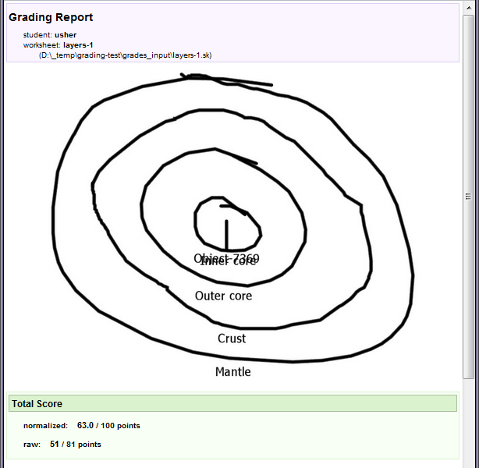
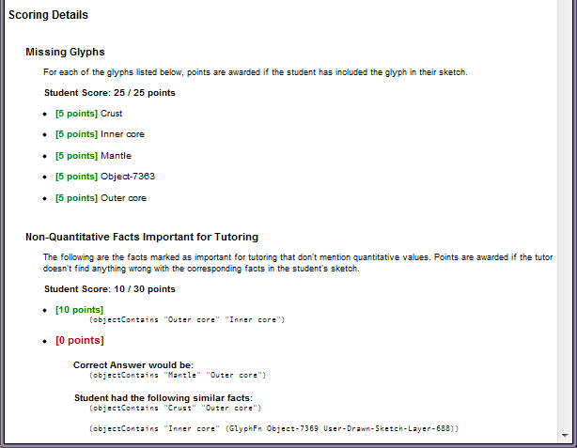
Gradebook: example grade report
Opt-in “phone home” data collection, all identifying information removed

Slide 45

CogSketch Team + Collaborators
CogSketch Developers (NU)
  Ken Forbus
  Madeline Usher
  Andrew Lovett
  Jon Wetzel
  Maria Chang
Geoscience Collaborators
  Brad Sageman (NU)
  Andrew Jacobson (NU)
  Basil Tikoff (Wisconsin)
  Bridget Garnier (Wisconsin)
  Sarah Titus (Carleton)
  Carol Ormand (Carleton)
Psychology & Education Research Collaborators
  Sian Beilock (U Chicago)
  Dedre Gentner (NU)
  Louis Gomez (Pitt)
  Garett Honke (NU)
  Susan Levine (U Chicago)
  Nora Newcombe (Temple U)
  Terry Regier (U Chicago)
  Tim Shipley (Temple U)
  David Uttal (NU)
DTC Collaborators (NU)
  Bruce Ankenman
  John Anderson
  Stacy Benjamin
http://www.spatiallearning.org

